Slide 1
Managing Research Data
Survival Skills Series
Notes:
Introduce myself – sci lib, work with DAVIS (more about us later)
Managing research data:
File naming
File organization
Adding metadata (data to your data about your data)

Slide 2
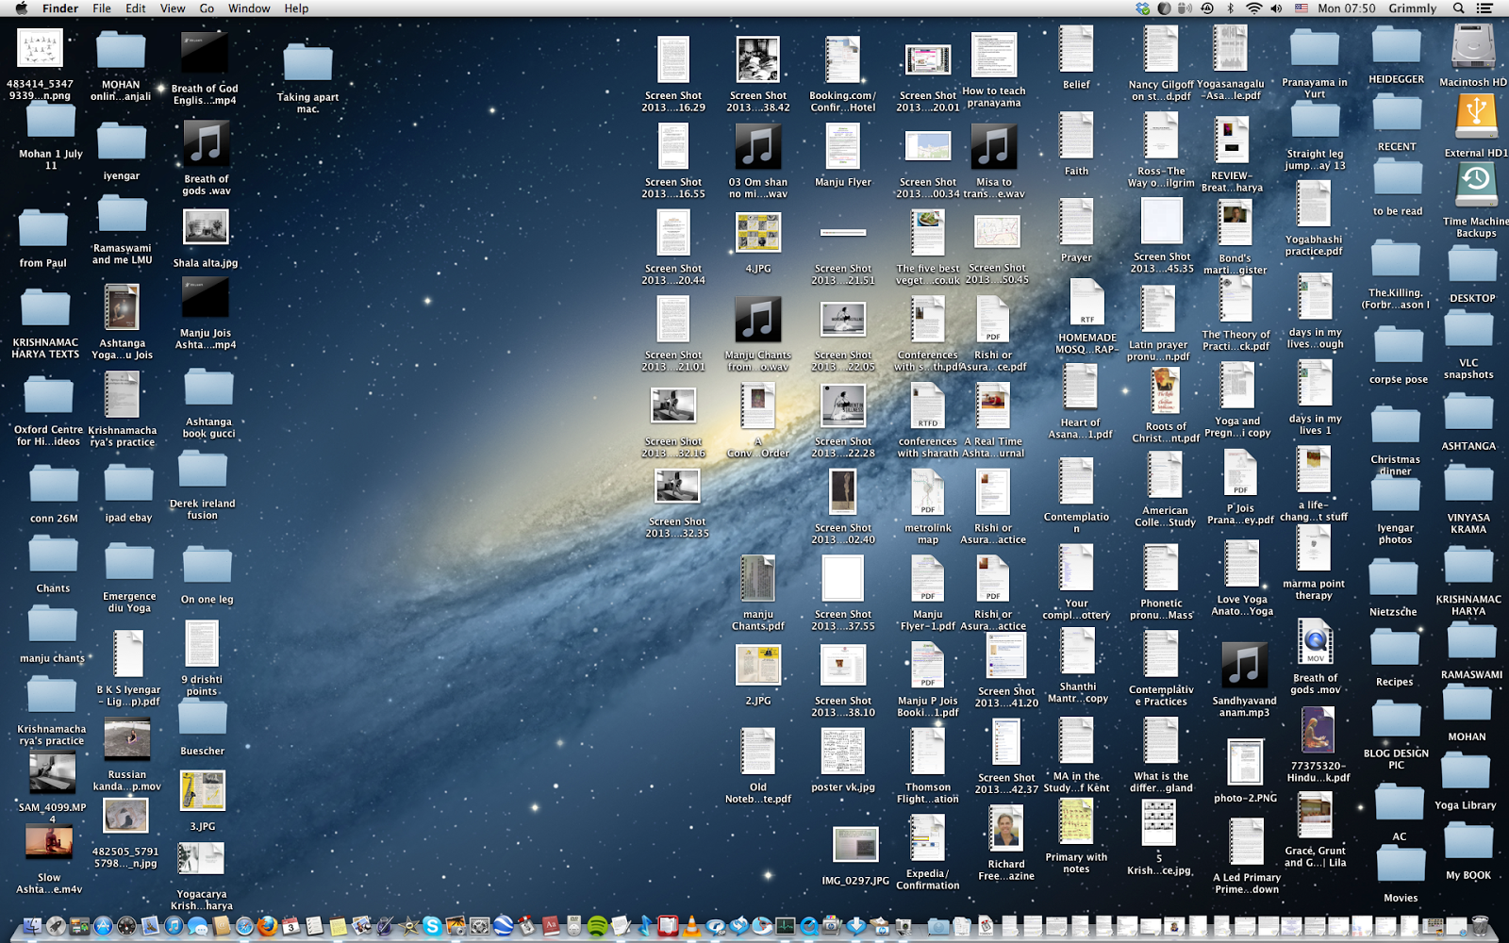
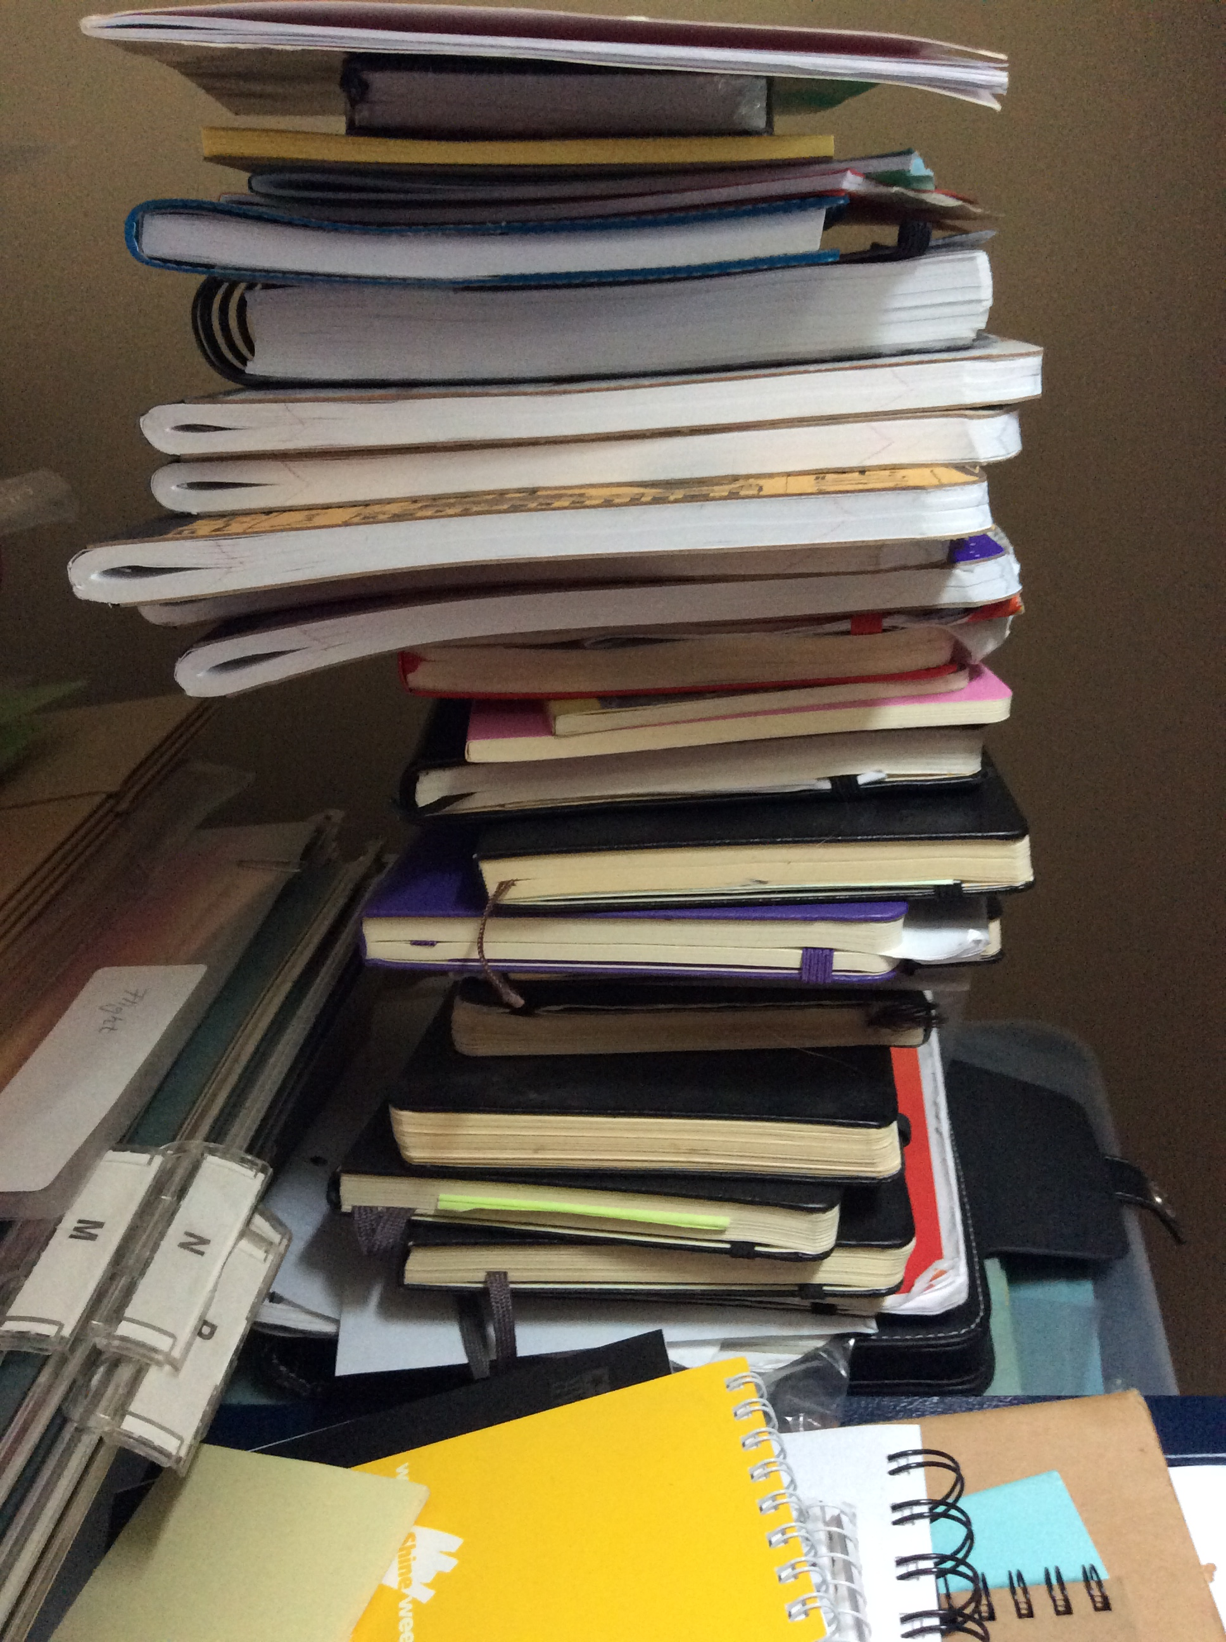

Managing Research Data
Why think about these things?
Discoverability
You
Others
Collaboration
Reproducibility
Notes:
Why?
With research, you are writing the book. No source/textbook to refer to.

Slide 3
Managing Research Data
Why think about these things?
Discoverability
You
Others
Collaboration
Reproducibility
Notes:
Communicate with future you.

Slide 4
Managing Research Data
Why think about these things?
Discoverability
You
Others
Collaboration
Reproducibility
Notes:
Leaving a lab/research group
Summer research
Undergrad project
Graduating
New job

Slide 5
Managing Research Data
Why think about these things?
Discoverability
You
Others
Collaboration
Reproducibility
Notes:
Working with people on the same/similar data?
Share storage; cloud, hard drive?

Slide 6
Managing Research Data
Why think about these things?
Discoverability
You
Others
Collaboration
Reproducibility
Notes:
For Science!
If it’s easy (for you or if you make it public) to find your data, it’s easy to share your data, more people will use your data
After publishing, if someone asks for something, you will save time by having followed these strategies for managing your data.

Slide 7


Amanda’s Research Project
 | 20121103_ra179.7dec12.1_g.fits
 | 20121103_ra179.7dec12.1_r.fits
 | 20121103_ra179.7dec12.1_spec.fits
 | 20121104_ra180.0dec12.1_g.fits
 | 20121104_ra180.0dec12.1_r.fits
 | 20121104_ra180.0dec12.1_spec.fits
 | galaxy1_g_crop.fits
 | galaxy1_r_crop.fits
 | galaxy1_spec_restframe.fits
 | galaxy2_g_crop.fits
 | galaxy2_r_crop.fits
 | galaxy2_spec_restframe.fits
observations
 | 1303.7762.pdf
 | 2dfft.py
 | BHmass.py
 | E&M class notes
 | mass & pitch angle scatter.png
 | paper on mass estimates.pdf
 | redshift(z)histogram
 | results
 | spiral paper.pdf
Notes:
Handouts option – pass out a worksheet with this same representation, ask groups to discuss for a few minutes
What do you know?
What is Amanda looking at?
What is this background information she spoke of?
What measurements has she made?
What analysis has she done?

Slide 8
File Naming
Be descriptive!
Is a date appropriate? YYYYMMDDleafcolor.dat
Are there multiple observers? YYYYMMDD_counts_ABS.csv
Use – or _ or capitalization instead of spaces
this file.docx
ThisFile.docx
this_file.docx
Don’t use special characters like !@#$%^&
File extensions are important (.txt, .csv, .exe)
Be consistent – are there guidelines already in place?
Notes:
File name communicates contents w/o having to open
-> adds some metadata

Slide 9
File Naming
Be descriptive!
Is a date appropriate? YYYYMMDDleafcolor.dat
Are there multiple observers? YYYYMMDD_counts_ABS.csv
Use – or _ or capitalization instead of spaces
this file.docx
ThisFile.docx
this_file.docx
Don’t use special characters like !@#$%^&
File extensions are important (.txt, .csv, .exe)
Be consistent – are there guidelines already in place?
Notes:
data.csv might be fine at the beginning but you could have different projects/datasets

Slide 10
File Naming
Be descriptive!
Is a date appropriate? YYYYMMDDleafcolor.dat
Are there multiple observers? YYYYMMDD_counts_ABS.csv
Use – or _ or capitalization instead of spaces
this file.docx
ThisFile.docx
this_file.docx
Don’t use special characters like !@#$%^&
File extensions are important (.txt, .csv, .exe)
Be consistent – are there guidelines already in place?

Slide 11
File Naming
Be descriptive!
Is a date appropriate? YYYYMMDDleafcolor.dat
Are there multiple observers? YYYYMMDD_counts_ABS.csv
Use – or _ or capitalization instead of spaces
this file.docx
ThisFile.docx
this_file.docx
Don’t use special characters like !@#$%^&
File extensions are important (.txt, .csv, .exe)
Be consistent – are there guidelines already in place?
Notes:
Need them to be machine readable – to read into some programs, to share

Slide 12
File Naming
Be descriptive!
Is a date appropriate? YYYYMMDDleafcolor.dat
Are there multiple observers? YYYYMMDD_counts_ABS.csv
Use – or _ or capitalization instead of spaces
this file.docx
ThisFile.docx
this_file.docx
Don’t use special characters like !@#$%^&
File extensions are important (.txt, .csv, .exe)
Be consistent – are there guidelines already in place?
Notes:
ThisIsCamelCase
Eliminated spaces but can still read the name

Slide 13
File Naming
Be descriptive!
Is a date appropriate? YYYYMMDDleafcolor.dat
Are there multiple observers? YYYYMMDD_counts_ABS.csv
Use – or _ or capitalization instead of spaces
this file.docx
ThisFile.docx
this_file.docx
Don’t use special characters like !@#$%^&
File extensions are important (.txt, .csv, .exe)
Be consistent – are there guidelines already in place?
Notes:
Again, machine readable

Slide 14
File Naming
Be descriptive!
Is a date appropriate? YYYYMMDDleafcolor.dat
Are there multiple observers? YYYYMMDD_counts_ABS.csv
Use – or _ or capitalization instead of spaces
this file.docx
ThisFile.docx
this_file.docx
Don’t use special characters like !@#$%^&
File extensions are important (.txt, .csv, .exe)
Be consistent – are there guidelines already in place?
Notes:
Can change how a computer will read/open
Helps in recognizing – don’t expect your R code to be in a PDF file

Slide 15
File Naming
Be descriptive!
Is a date appropriate? YYYYMMDDleafcolor.dat
Are there multiple observers? YYYYMMDD_counts_ABS.csv
Use – or _ or capitalization instead of spaces
this file.docx
ThisFile.docx
this_file.docx
Don’t use special characters like !@#$%^&
File extensions are important (.txt, .csv, .exe)
Be consistent – are there guidelines already in place?
Notes:
The example is high-level nomenclature
http://classic.sdss.org/dr6/dm/flatFiles/spSpec.html
https://www.sdss.org/dr14/manga/manga-data/data-model/
Long file names, nested folders (long path) can cause problems with certain tools like command line

Slide 16
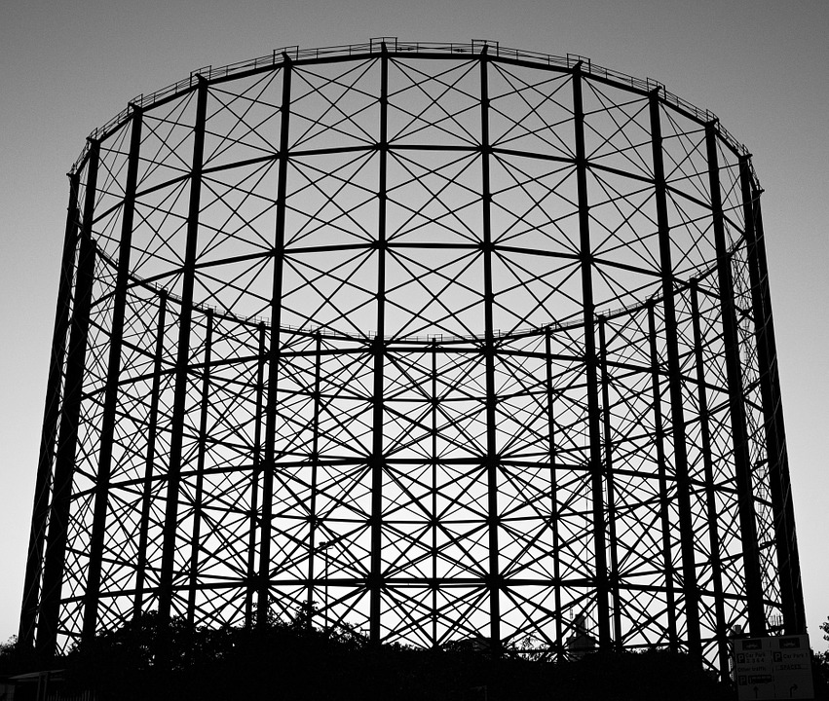
File Organization
new_research_project
data
raw_data
processed_data
analysis
question1
question2
literature
write_up
Notes:
Organization = you can search and find
Being able to share is secondary
For certain projects, dynamically linking, if Excel is your primary tool interaction with your data

Slide 17
README files
Create README for each file or data set
Write as plain text file
Information to include:
https://libraries.ou.edu/content/how-make-readmetxt-file
Notes:
Metadata!
START WITH EXAMPLE - http://cdsarc.u-strasbg.fr/viz-bin/Cat?cat=B%2Fchandra&target=readme&menu=on

Slide 18
README files
Create README for each file or data set
Write as plain text file
Information to include:
https://libraries.ou.edu/content/how-make-readmetxt-file

Slide 19
README files
Create README for each file or data set
Write as plain text file
Information to include:
https://libraries.ou.edu/content/how-make-readmetxt-file

Slide 20
README files
Create README for each file or data set
Write as plain text file
Information to include:
https://libraries.ou.edu/content/how-make-readmetxt-file
Notes:
Go to libraries.ou.edu and search for readme file

Slide 21
Amanda’s Research Project
File Naming
be descriptive
no special characters or spaces
use file extensions
Organize / add structure
Include READMEs
 | 20121103_ra179.7dec12.1_g.fits
 | 20121103_ra179.7dec12.1_r.fits
 | 20121103_ra179.7dec12.1_spec.fits
 | 20121104_ra180.0dec12.1_g.fits
 | 20121104_ra180.0dec12.1_r.fits
 | 20121104_ra180.0dec12.1_spec.fits
 | galaxy1_g_crop.fits
 | galaxy1_r_crop.fits
 | galaxy1_spec_restframe.fits
 | galaxy2_g_crop.fits
 | galaxy2_r_crop.fits
 | galaxy2_spec_restframe.fits
observations
 | 1303.7762.pdf
 | 2dfft.py
 | BHmass.py
 | E&M class notes
 | mass & pitch angle scatter.png
 | paper on mass estimates.pdf
 | redshift(z)histogram
 | results
 | spiral paper.pdf
Notes:
Handouts option – pass out a worksheet with this same representation, ask groups to discuss for a few minutes

Slide 22
BlackHoleMass_SpiralGalaxy
analysis
plots
 | mass_pitchangle_scatter.png
 | redshift_histogram.png
 | galaxy1_g_crop.fits
 | galaxy1_r_crop.fits
 | galaxy1_spec_restframe.fits
 | galaxy2_g_crop.fits
 | galaxy2_r_crop.fits
 | galaxy2_spec_restframe.fits
 | README.txt
 | README_methods.txt
 | 2dfft.py
 | BHmass.py
 | results.csv
 | README.txt
data
processed
 | 20121103_ra179.7dec12.1_g.fits
 | 20121103_ra179.7dec12.1_r.fits
 | 20121103_ra179.7dec12.1_spec.fits
 | 20121104_ra180.0dec12.1_g.fits
 | 20121104_ra180.0dec12.1_r.fits
 | 20121104_ra180.0dec12.1_spec.fits
 | README.txt
raw
 | BHmass_pitch.bib
 | KormandyHo2013.pdf
 | Lusso2010.pdf
 | Vertergaard2006.pdf
literature
 | README.txt

Slide 23
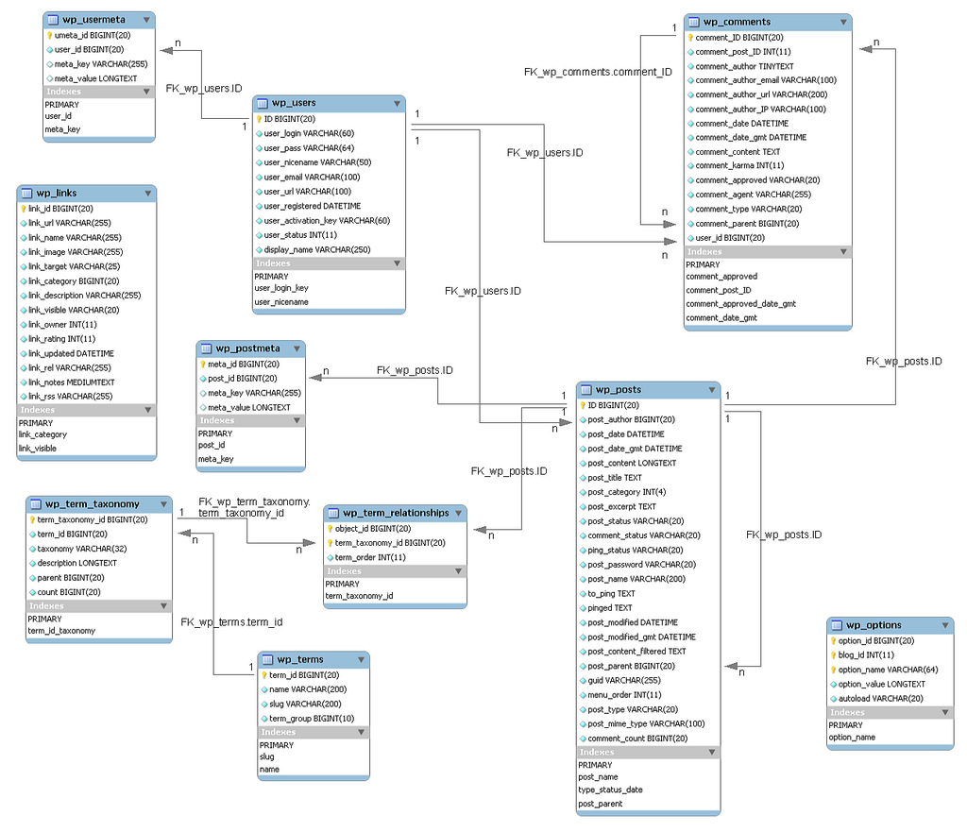
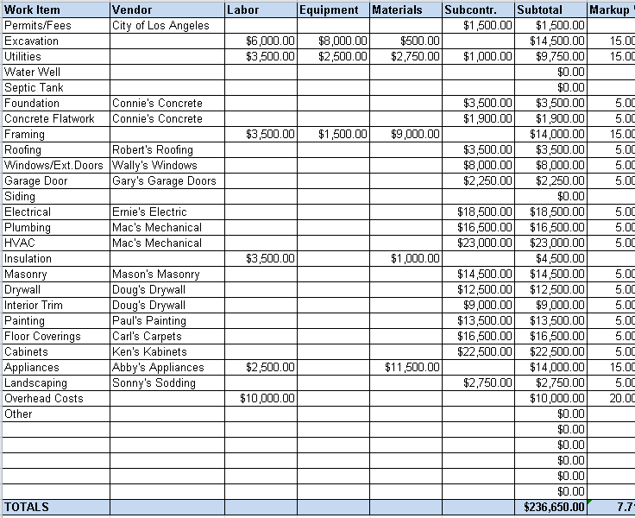
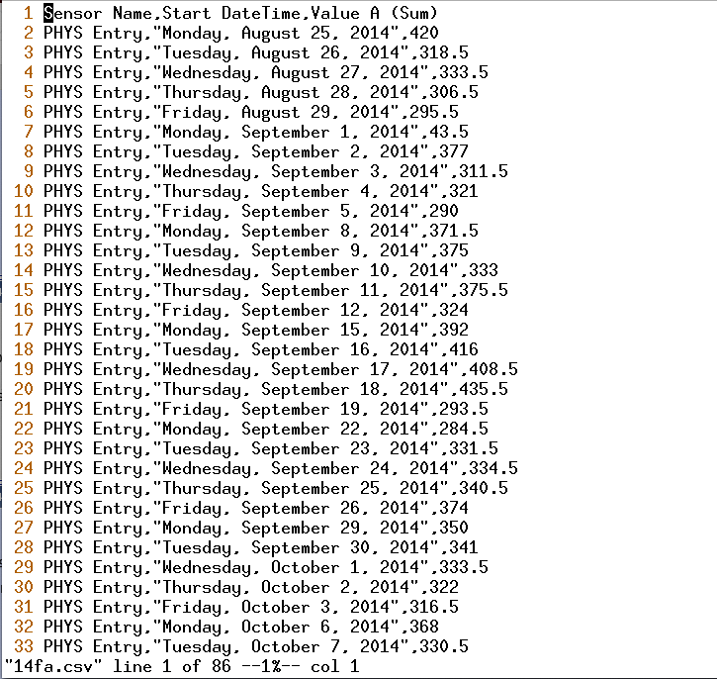




Data organization
Spreadsheets
Flat files (csv/tsv/txt)
Database
Notes:
Spreadsheets – tables that we interact with through software like excel,
“Flat” files – no formatting, just text, lists of data
Database – container that adds structure to data (kind of like directories/folders for our files)

Slide 24
Data organization
Spreadsheets
Available/familiar software
Edit directly
Quickly analyze, make charts
Notes:
Spreadsheets are a good place to start

Slide 25
Data organization
Flat files (csv/tsv/txt)
Read by many programs (including excel)
Use a programming language to analyze, connect to other tables
Notes:
Flat = no formatting
csv = comma separated values

Slide 26
Data organization
Database
Use with relational data
Can handle large data sets
Complex searching options
Notes:
Database – organized collection of data; container that adds structure to data
Relational data – example several tables that relate to each other, can be used together
Accessed through software or language; e.g. SQL – structured query language, covered in Carpentries

Slide 27
More on managing data
Version control – TODAY, 2-4:30, here
Formatting data for analysis - Tidy Data: Fri. May 3, 11am
Data Management Plans - Mark Laufersweiler, Research Data Specialist
Notes:
Today we discussed some data management good practices but there’s more
backing up data & having a plan for that
Cleaning your data (tidy data) to make analysis robust & efficient
Data Management Plans – more often being required for funding grants; plans for storing/sharing/backing up;

Slide 28
Find more resources and upcoming events!
Carpentries two-day workshops https://libraries.ou.edu/ carpentries
Information Specialists @ DAVIS https://libraries.ou.edu/davis
Digital Scholarship Lab https://libraries.ou.edu/dsl
Notes:
Carpentries – cover various topics about foundational coding and data science skills
SWC – shell tasks, version control, programming in Python or R
DC – spreadsheets, cleaning data, databases (SQL), analytics/visualization w/R

Slide 29
Please take 5 min to help us improve
Survey link
bit.ly/oulib_davis_workshop
Today’s topic
Survival Skills: Managing Research Data

